Slide 1
Object Detection
Presented : Muhammad Zaqeem

Slide 2
Overview:
Classification vs Localization
Object Detection
Window Sliding Approch
Intersection Over Union (IOU)
Non-Maximum Suppression(NMS)
One Stage vs Two Stage Detection

Slide 3
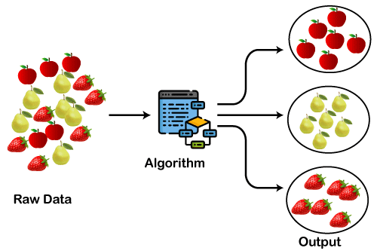
Classification vs Localization
Classification:
Task to assign a label or category to an input image or object.
Determine what is present in the image without specifying location
Limitation:
Object classification only assigns a label to an image but does not indicate the object's location within it.
Example:
The system classifies an image of fruit as belonging to the "Apple," "Mango," or "Strawberry" category.
This image illustrates how fruit are classified based on features.

Slide 4
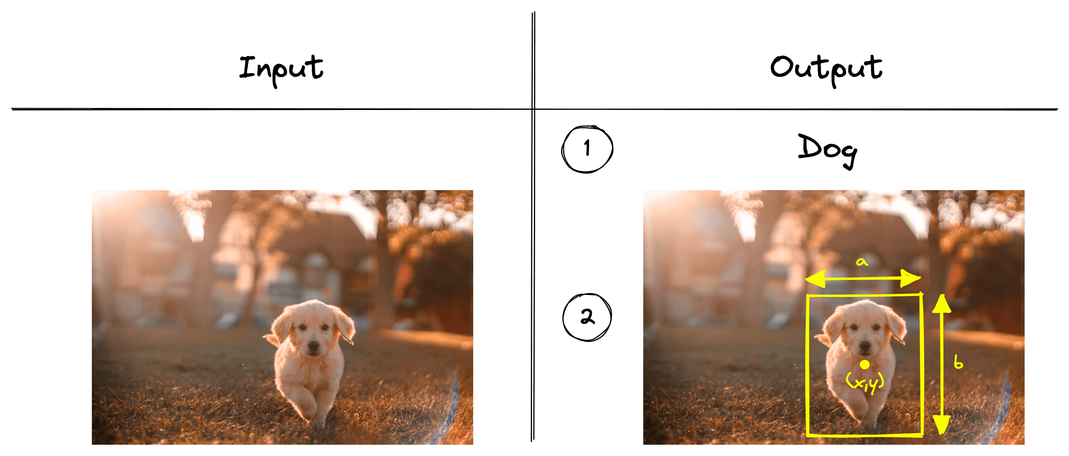
Classification vs Localization
Localization:
Predicting object locations within an image by drawing bounding boxes.
Provide spatial information about object positions.
Limitation:
Object localization is generally designed to detect one primary object in an image.
Example:
System predicts coordinates of a bounding box around a dog in an image.
Dog image with bounding box

Slide 5
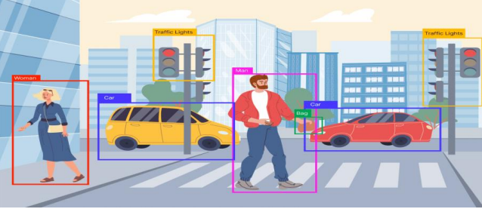
Object Detection
Identifying and localizing objects within an image by drawing bounding boxes around them.
Detect and localize objects, providing spatial information about their positions in the image.
Example:
Detecting and localizing multiple instances of cars, pedestrians, bicycles, traffic signs, and buildings with bounding boxes.
Traffic lights guiding the flow of vehicles and pedestrians safely.

Slide 6
Window Sliding Approch:
The Sliding Window Approach scans an image with a fixed-size window, moving step by step to detect objects.
How it Works:
Select a small rectangular window (smaller than the image).
Move the window across the image, cropping out that region.
Pass each cropped region to an image classifier to check if it contains an object.
Pass each cropped region to an image classifier to check if it contains an object.
At the end, store the regions where an object was detected.
Window is sliding over the image for detecting the car

Slide 7
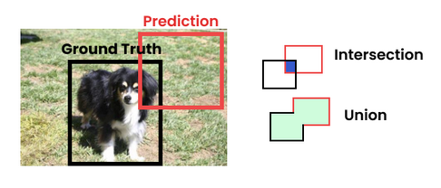
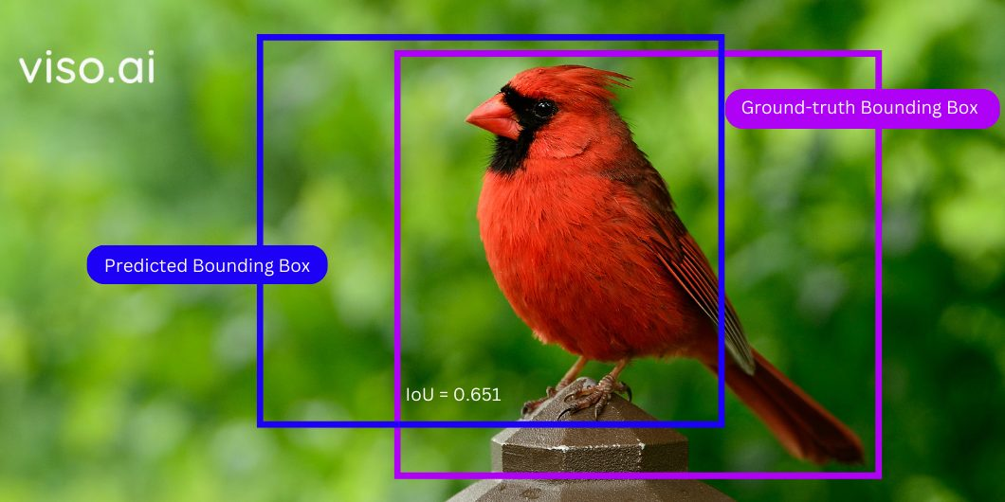
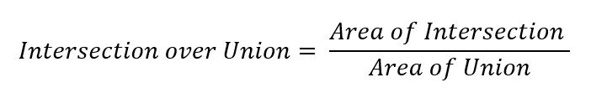
Intersection Over Union
IoU (Intersection over Union) is a metric used in object detection to measure how much two bounding boxes overlap.
It quantifies the accuracy of object localization by calculating the ratio of the area of intersection between the two bounding boxes to the area of their union.
Area of Intersection = Common area shared by the two bounding boxes (Overlap)
Area of Union = Total area covered by the two bounding boxes
IoU measures overlap between predicted and ground-truth boxes.

Slide 8
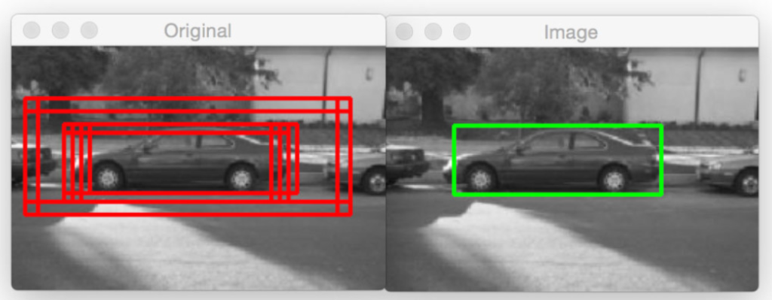
Non-Maximum Suppression
Non-Maximum Suppression (NMS) is used in object detection to remove redundant bounding boxes.
It selects the box with the highest confidence score and discards overlapping boxes.
Helps ensure each object is detected only once with the most accurate bounding box.
Improves precision and clarity of detection results.
NMS removes redundant boxes, keeping the most accurate detection.

Slide 9
One Stage vs Two Stage
Two-Stage Object Detectors:
Two-stage object detectors follow a two-step process for detecting objects in an image.
1 Region Proposal Generation:
Identifies candidate regions likely to contain objects.
Techniques: Selective Search, Edge Boxes, Region Proposal Networks (RPNs).
2 Object Classification & Refinement:
Classifies objects in proposed regions and refines bounding boxes.
Method: Uses CNN for feature extraction, followed by classification & regression.
Examples: Faster R-CNN, Cascade R-CNN, Mask R-CNN

Slide 10
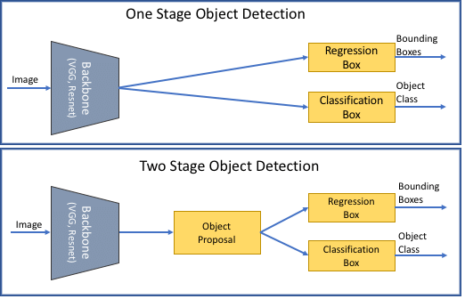
One Stage vs Two Stage
One Stage:
Detects objects directly in one step by predicting bounding boxes and class labels in a single pass.
They prioritize speed and efficiency by eliminating the region proposal step.
Example Models:
YOLO, SSD
Comparison of One-Stage and Two-Stage Object Detection.

Slide 11
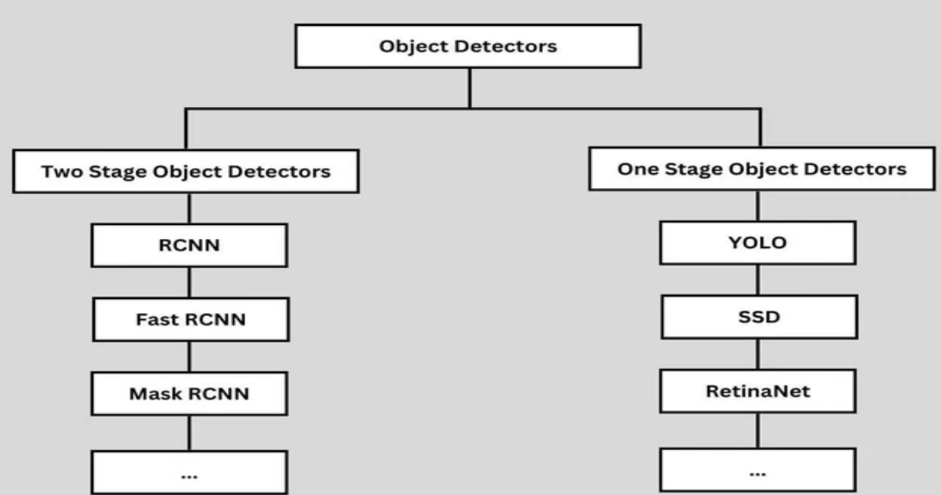
One Stage vs Two Stage
Two-Stage (RCNN, Fast RCNN, Mask RCNN) vs. One-Stage (YOLO, SSD, RetinaNet).

Slide 12

Thank You

